Slide 1
Function OVERLOADING

Slide 2
POLYMORPHISM

Slide 3
The term "Polymorphism" is the combination of "poly" + "morphs" which means many forms.
It is a greek word.
In object-oriented programming, we use 3 main concepts: inheritance, encapsulation, and polymorphism.
Real Life Example Of Polymorphism
Let's consider a real-life example of polymorphism.
A lady behaves like a teacher in a classroom, mother or daughter in a home and customer in a market.
Here, a single person is behaving differently according to the situations.

Slide 4
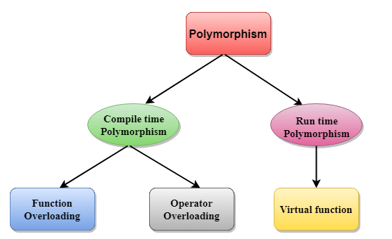

Slide 5
Compile time polymorphism:
The overloaded functions are invoked by matching the type and number of arguments.
This information is available at the compile time and, therefore, compiler selects the appropriate function at the compile time.
It is achieved by function overloading and operator overloading which is also known as static binding or early binding.
Run time polymorphism:
Run time polymorphism is achieved when the object's method is invoked at the run time instead of compile time.
It is achieved by method overriding which is also known as dynamic binding or late binding.

Slide 6
Function OVERLOADING

Slide 7
If we create two or more members having the same name but different in number or type of parameter, it is known as C++ overloading.
In C++, we can overload:
Methods
Constructors
Indexed properties
It is because these members have parameters only.
Types of overloading in C++ are:
Function overloading
Operator overloading

Slide 8
Function overloading is a feature of object oriented programming where two or more functions can have the same name but different parameters
When a function name is overloaded with different jobs it is called Function Overloading.
In Function Overloading “Function” name should be the same and the arguments should be different.
It is only through these differences compiler can differentiate between the functions.
Function overloading can be considered as an example of polymorphism feature in C++.
The advantage of Function overloading is that it increases the readability of the program because you don't need to use different names for the same action.

Slide 9
#include <iostream>
using namespace std;
void print(int i) {
cout << " one parameter " << i << endl;
}
void print(int i, int j) {
cout << "two parameters " << i<<" "<<j << endl;
}
void print(char *c) {
cout << " one text " << c << endl;
}
int main() {
print(10);
print(10,10);
print("ten");
}

Slide 10
#include <iostream>
using namespace std;
class lpu {
int c;
public:
void add(int a,int b){
c= a + b;
cout<<c<<endl;
}
void add(int a, int b, int c)
{ c= a + b + c;
cout<<c;
}
};
int main(void) {
lpu obj; // class object declaration.
obj.add(10,20);
obj.add(12, 20, 23);
}

